Slide 1


Employee
Reward and
Recognition-
2023-24

Slide 2
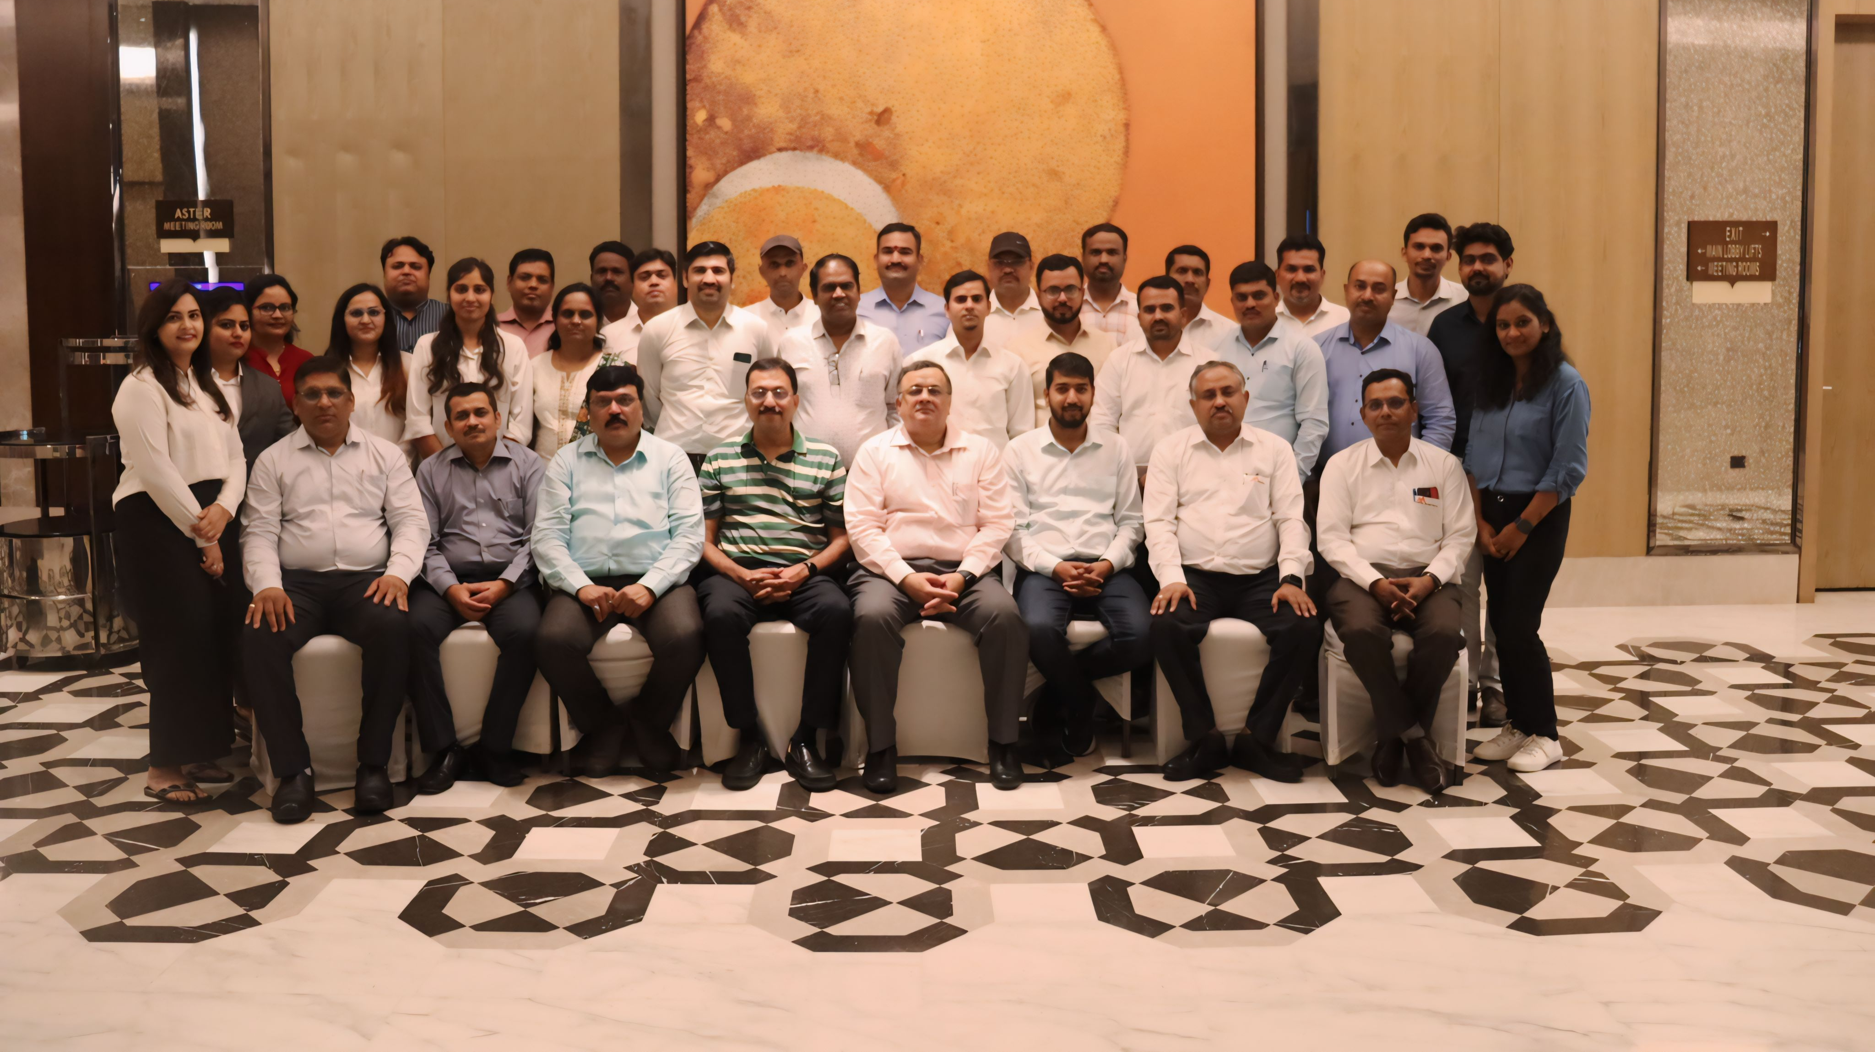

Slide 3
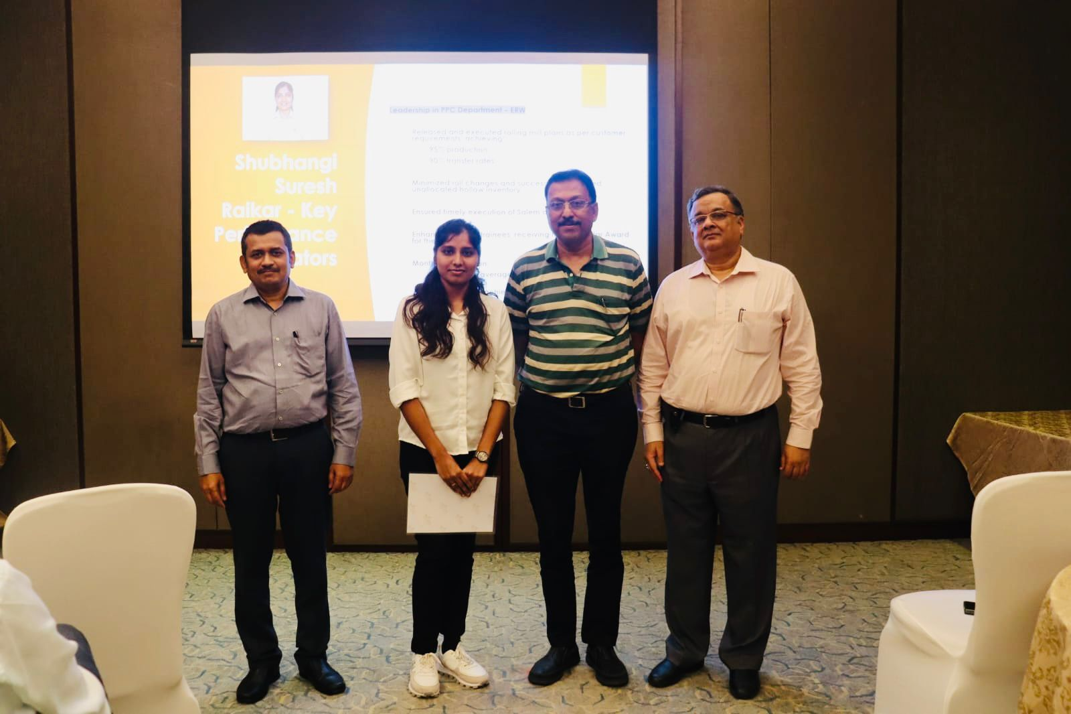
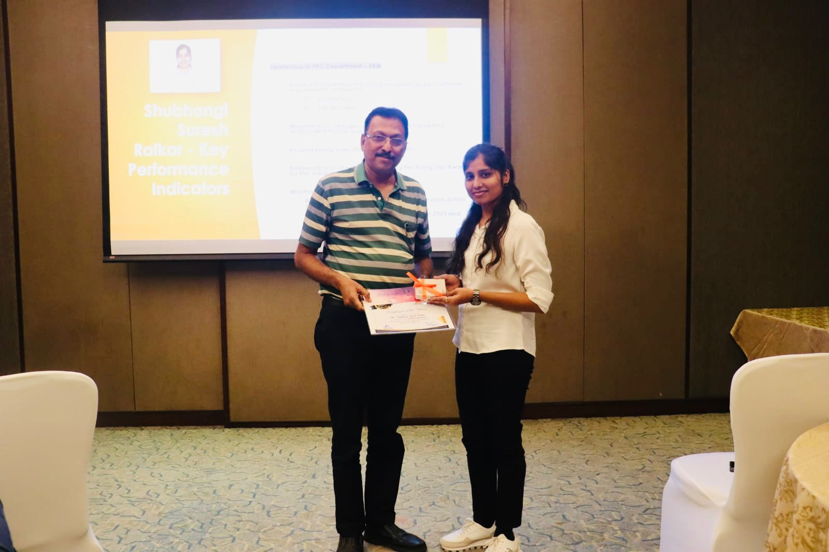
Employee of the Year 2023-24
Ms. Shubhangi Raikar ( Department- PPC)

Slide 4
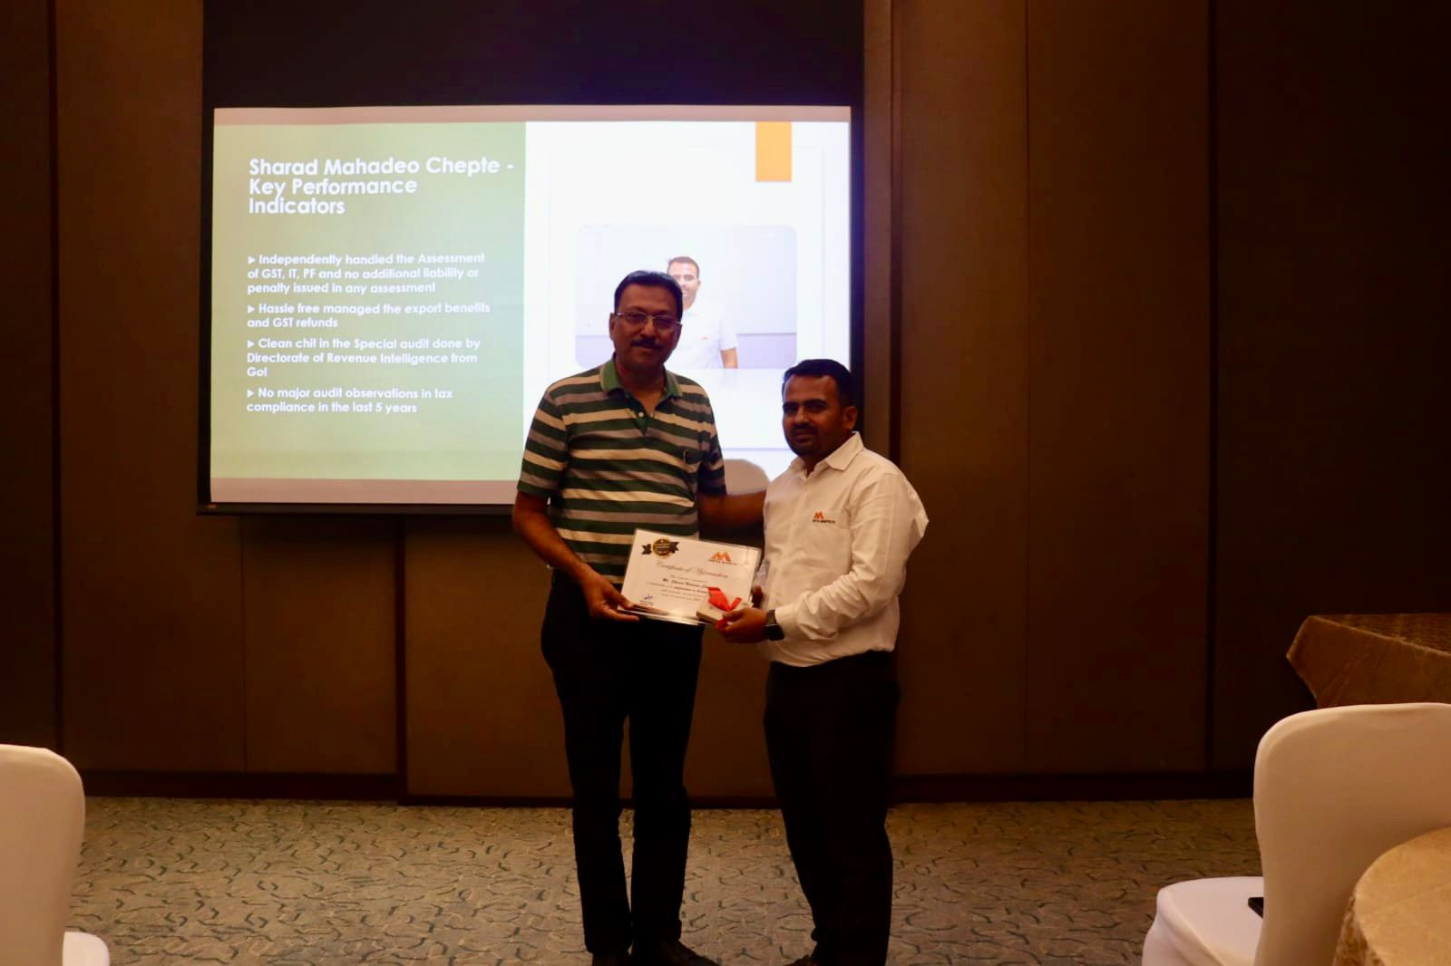
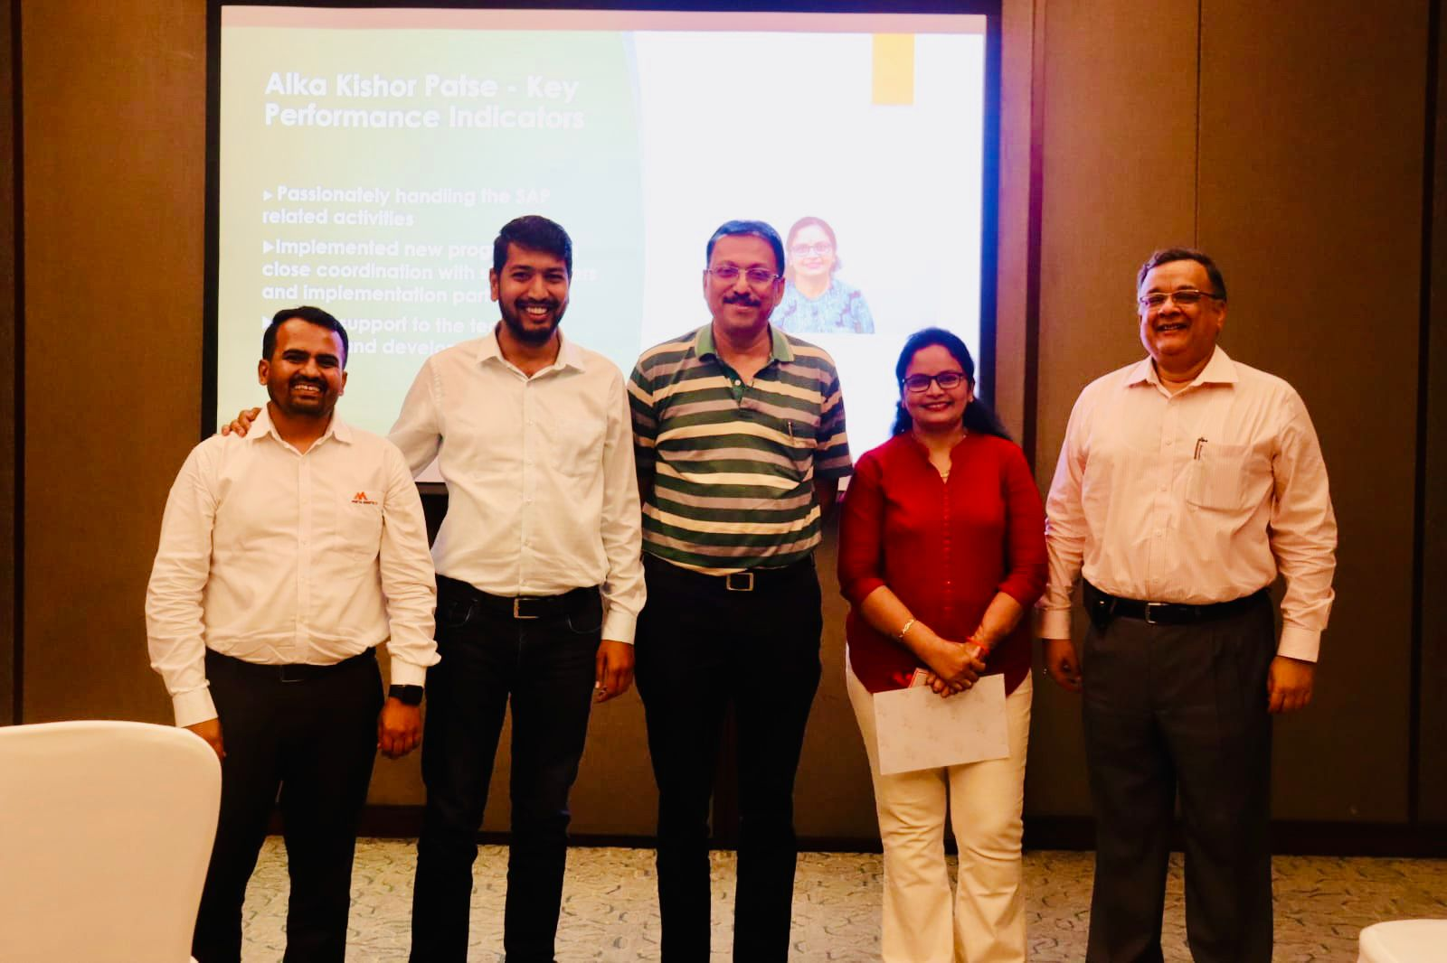
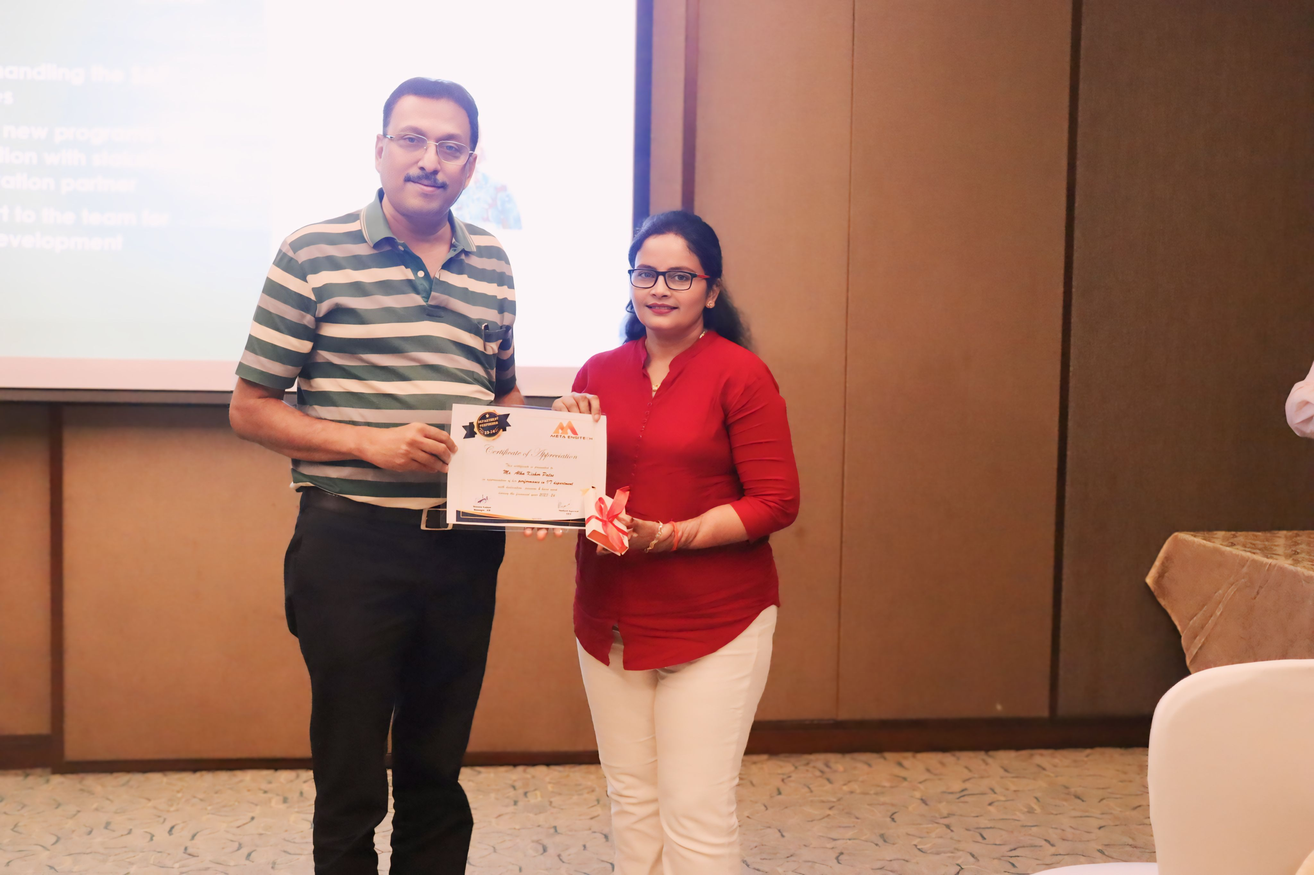
Glimpses of Department Performer – Account & IT
Mr. Sharad Chepte – Account
Mrs. Alka Patse – IT – SAP

Slide 5
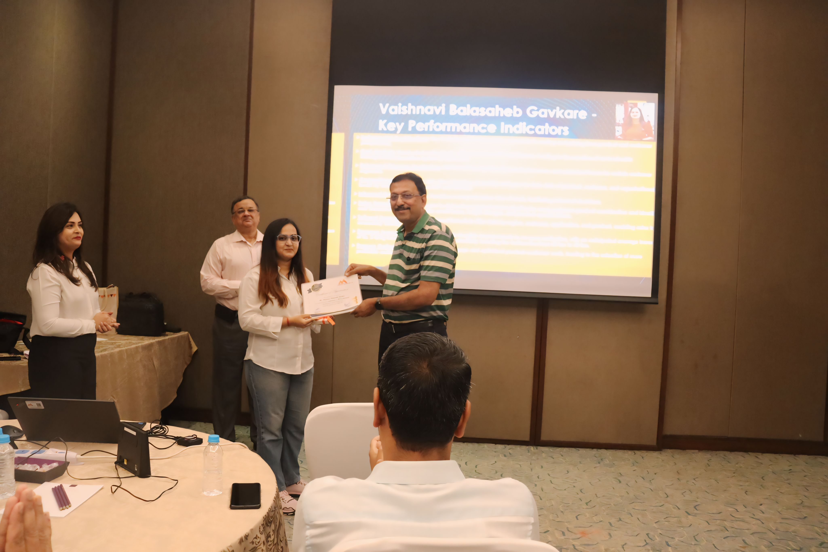
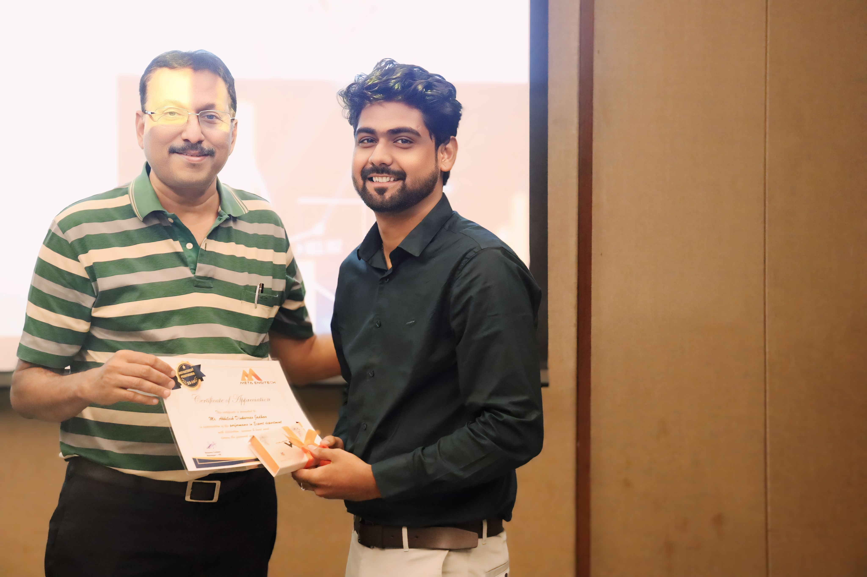
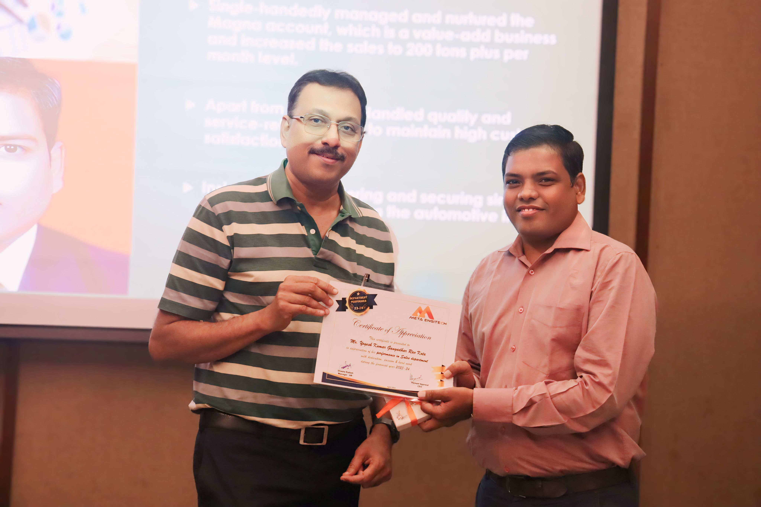
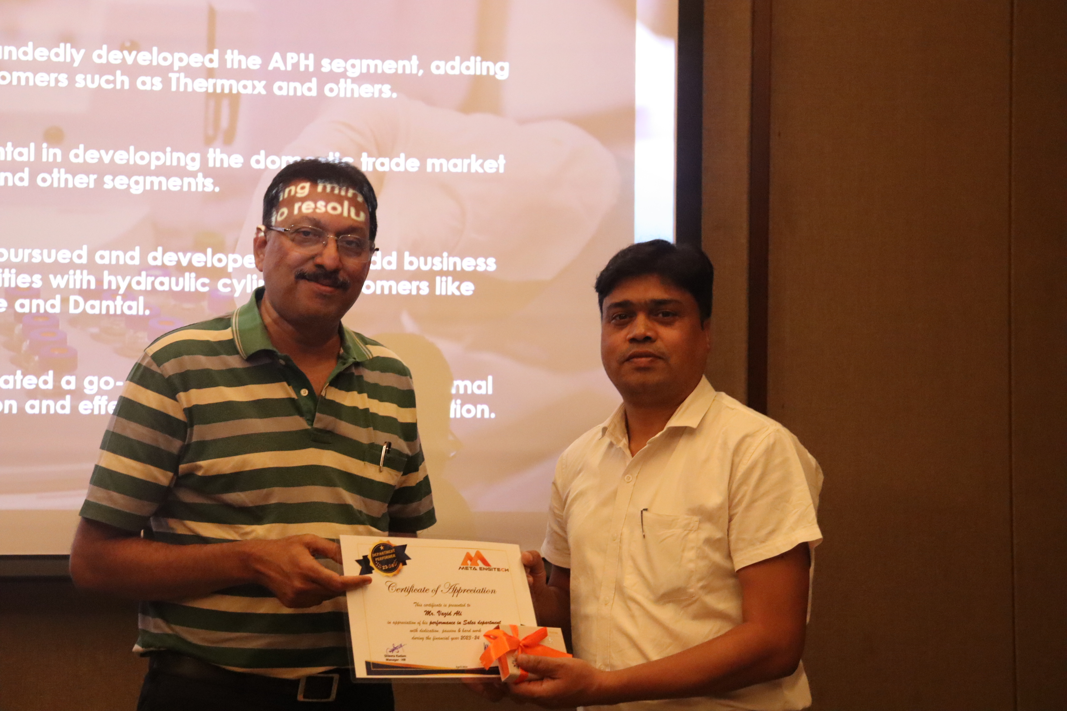
Glimpses of Department Performer – Sales, Export Sales, NPD, MIS
Ms. Vaishnavi Gavkare – MIS
Mr. Akhilesh Jadho – Export Sales
Mr. Yogesh Kota – Sales
Mr. Vazid Alli – Sales

Slide 6
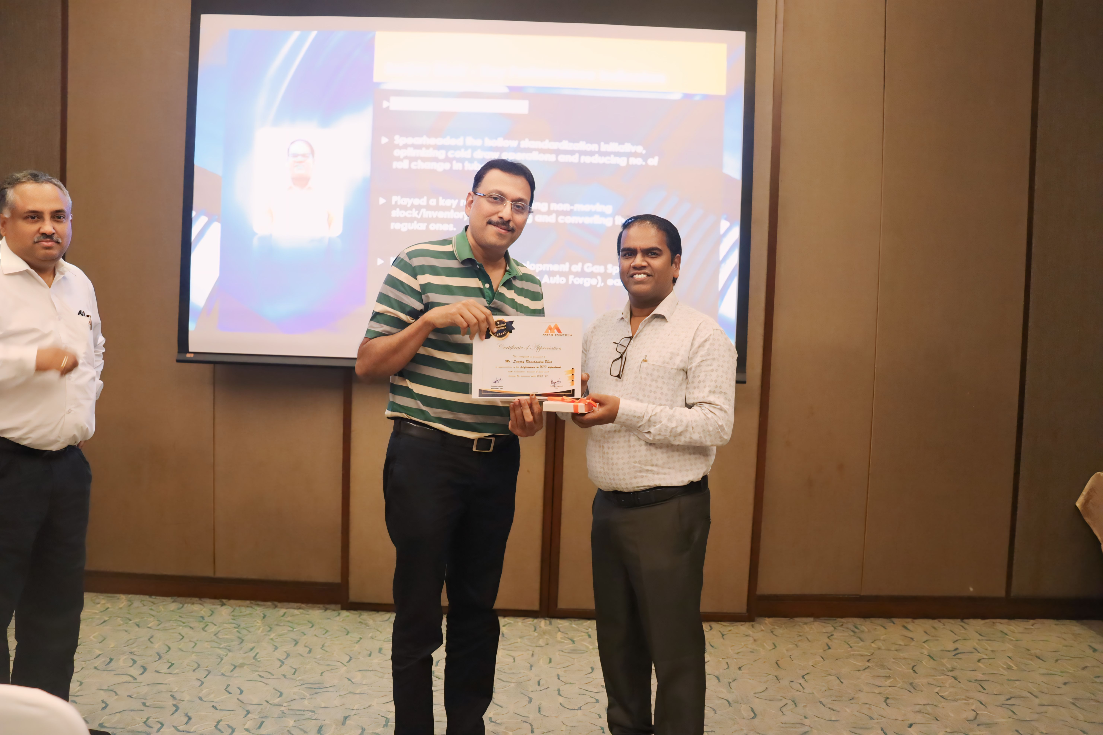
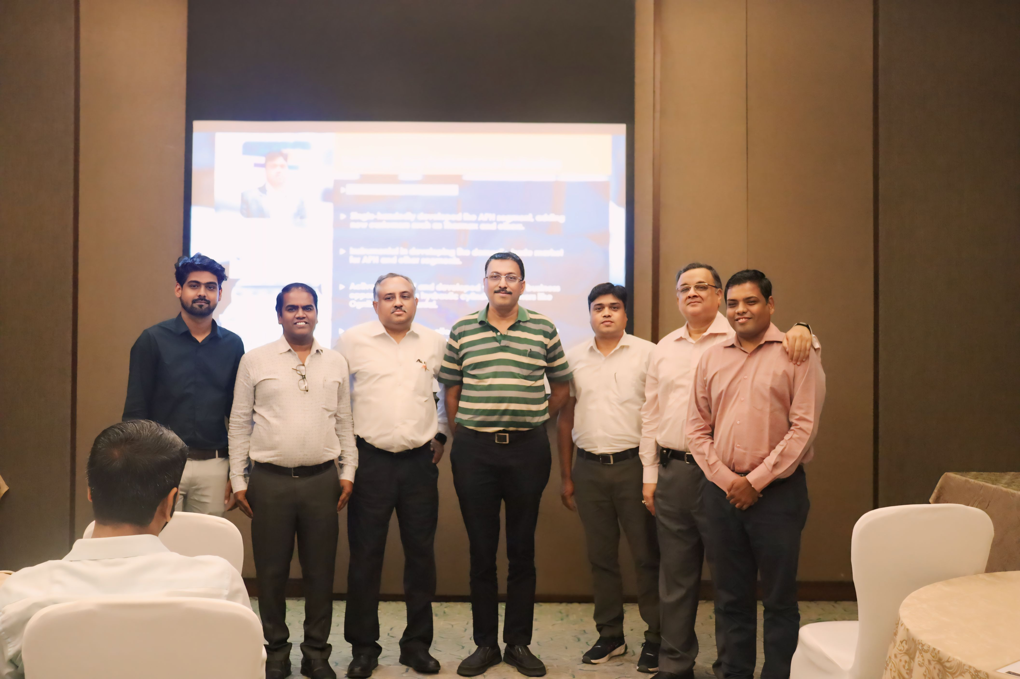
Glimpses of Department Performer Reward and Recognition
Mr. Sanjay Bhoir – NPD
Congratulations Team for your achievement

Slide 7
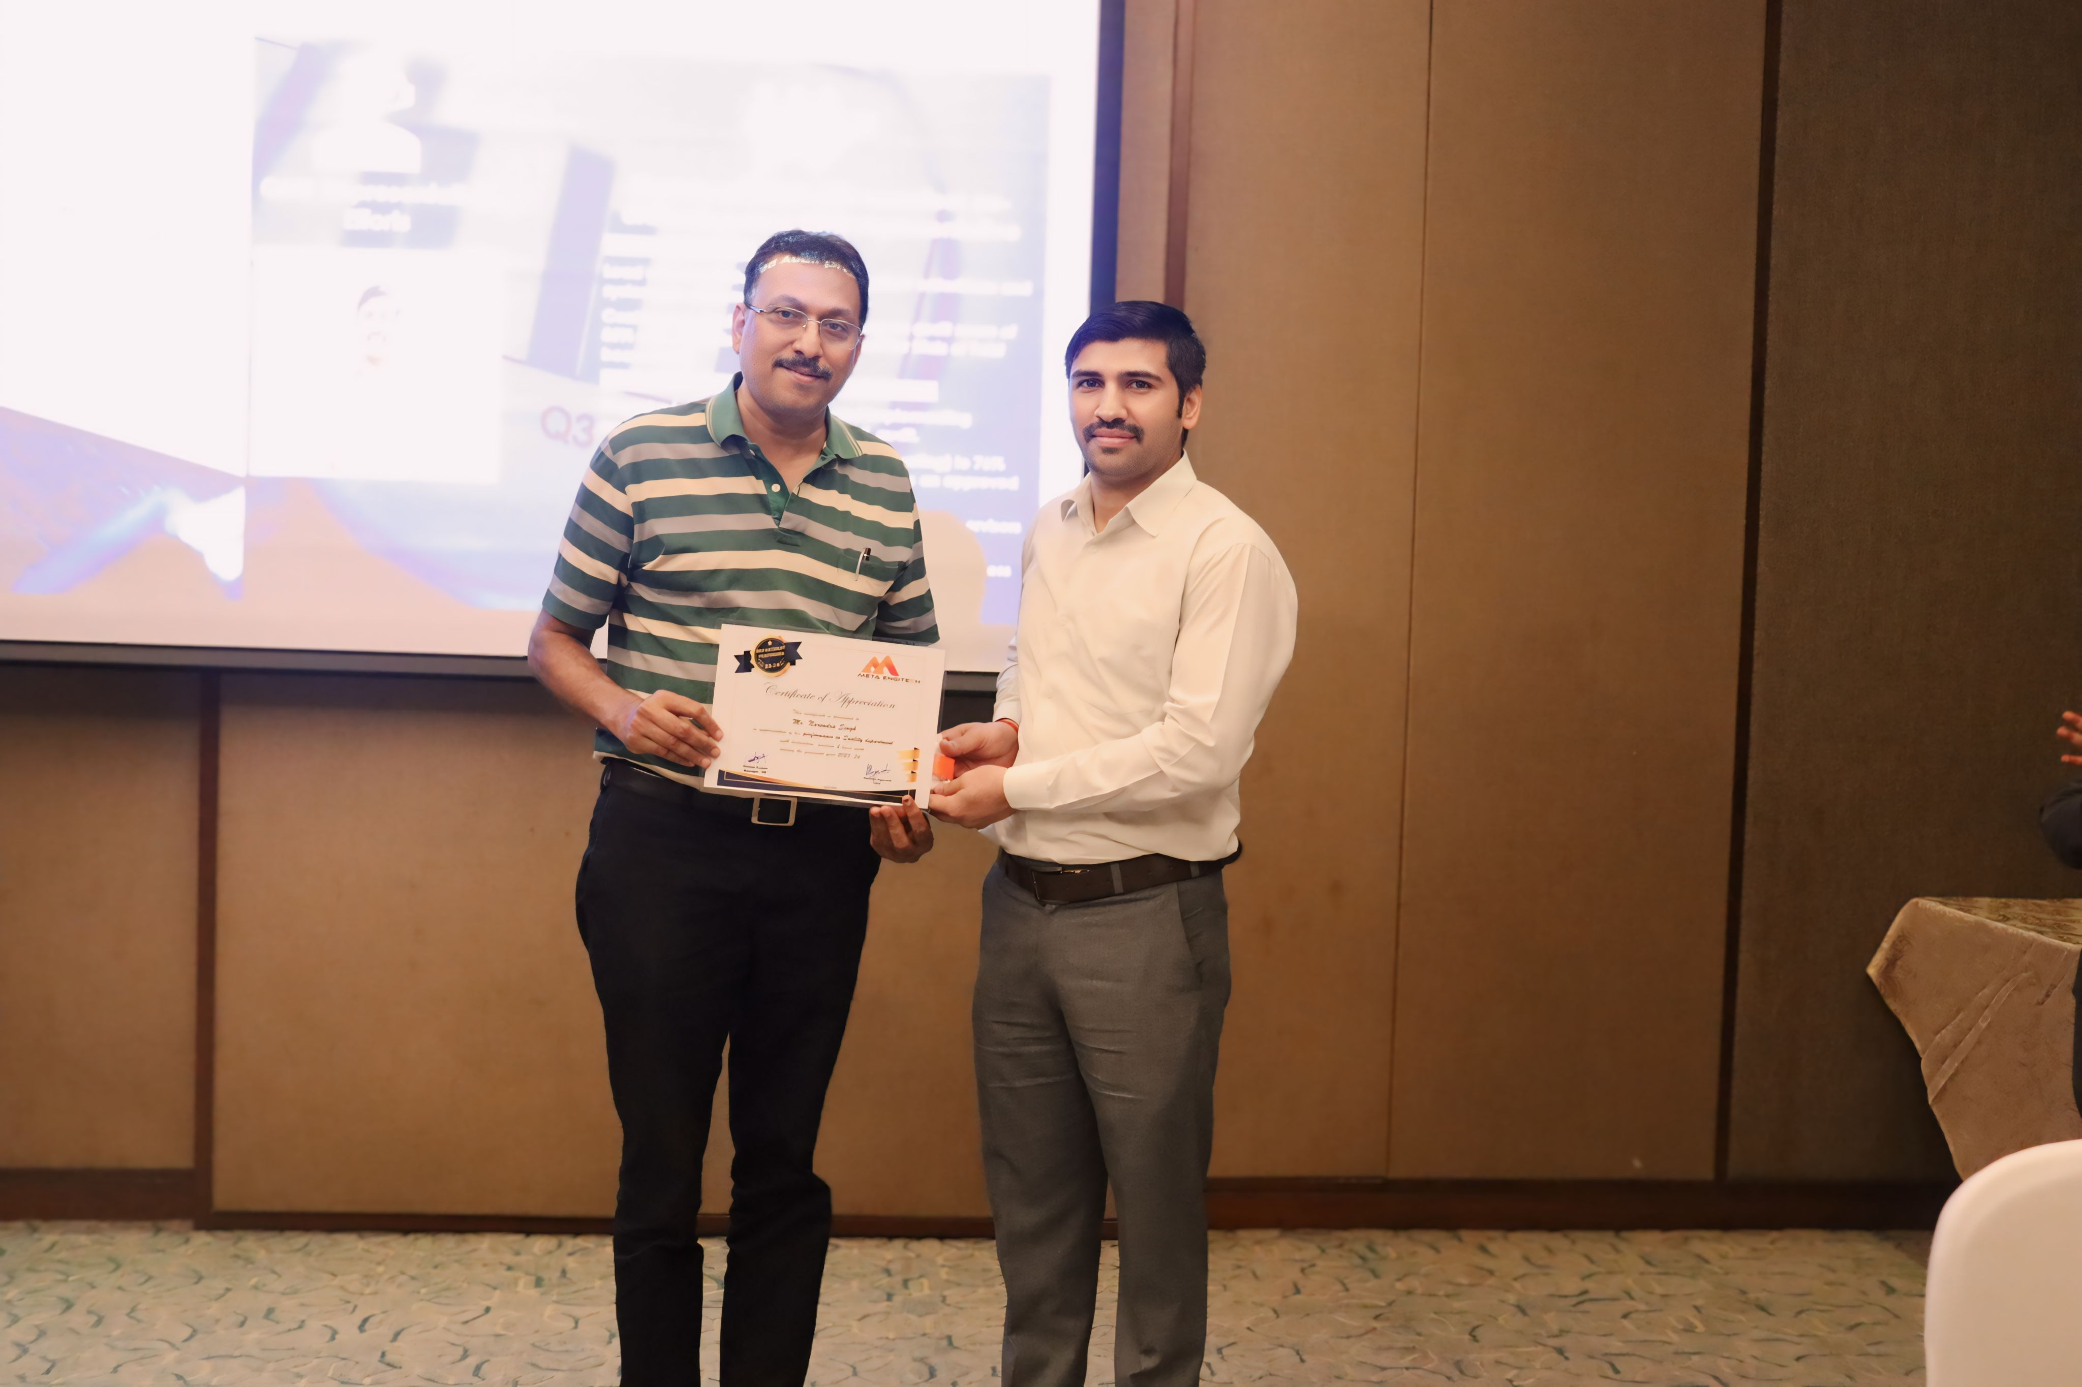
Glimpses of Department Performer – Quality
Mr. Rahul Adat – Quality
Mr. Narendra Singh – Quality

Slide 8
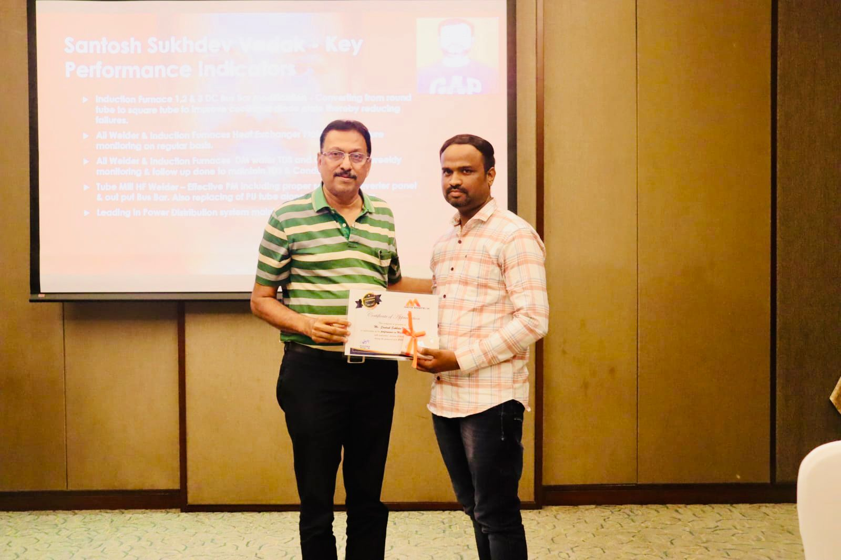
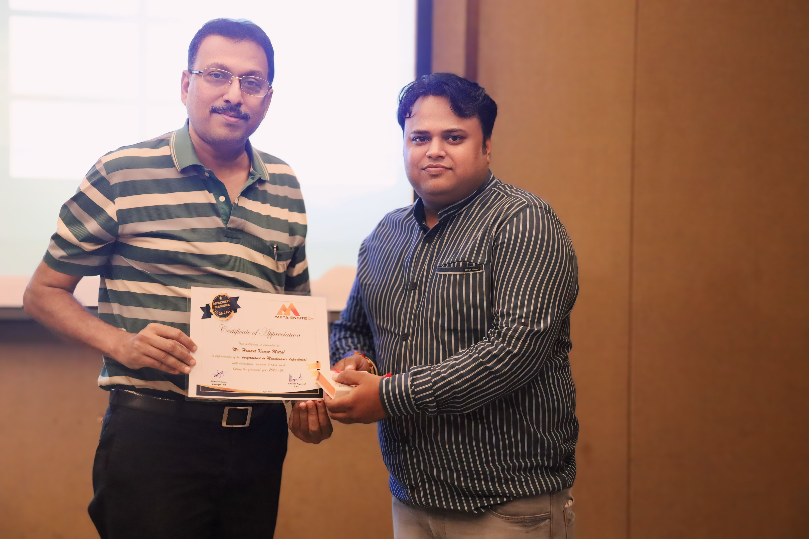
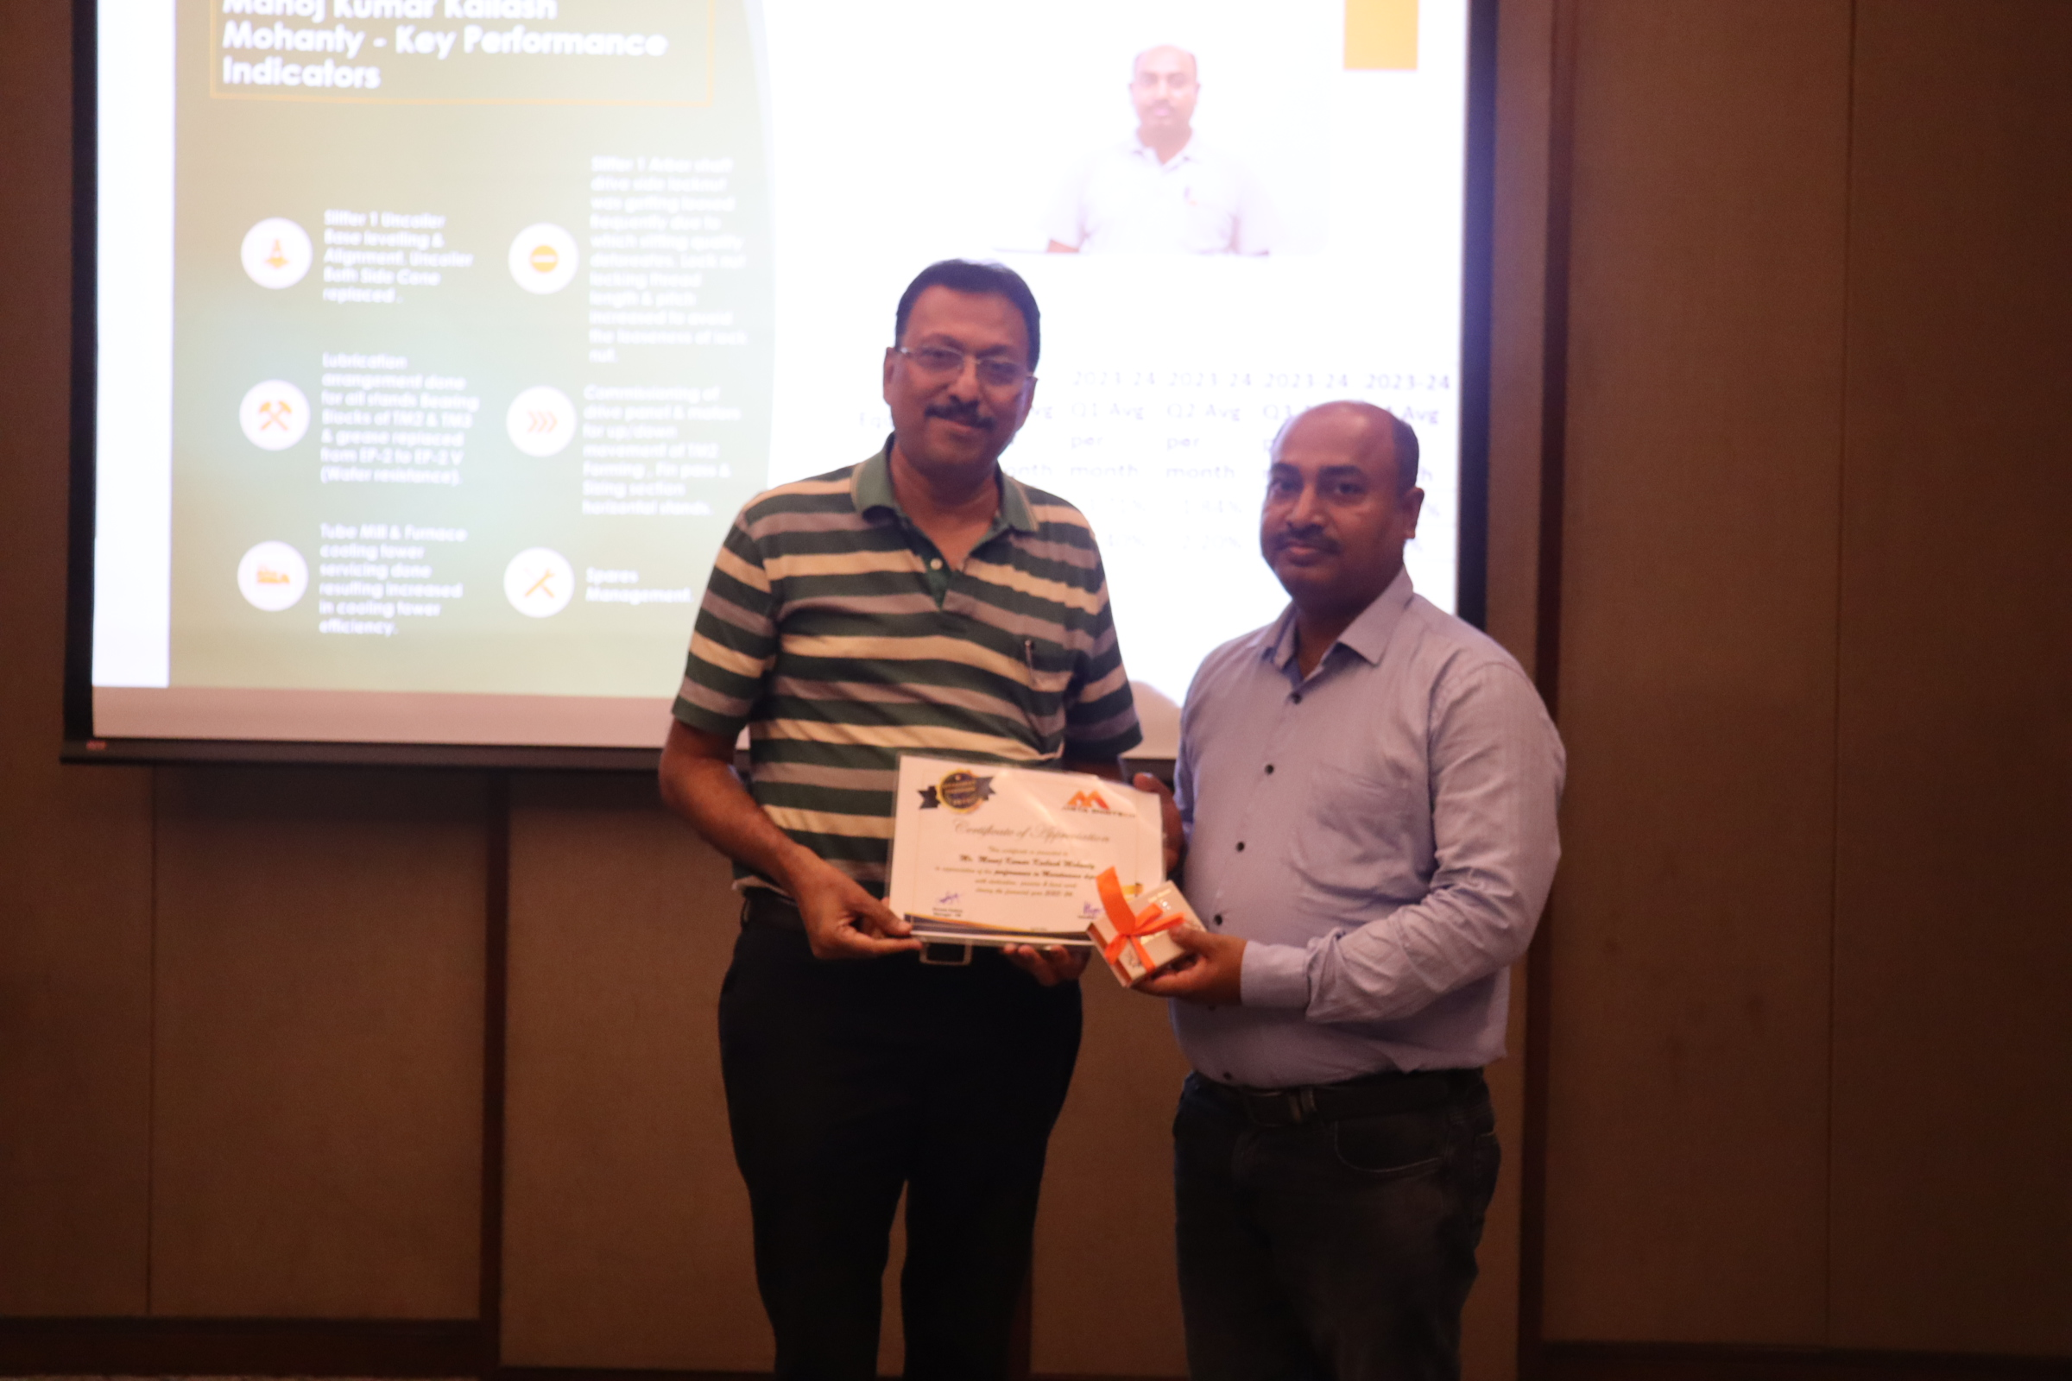
Department Performer – Maintenance
Mr. Santosh Vadak – Maintenance
Mr. Hemant Mittal – Maintenance
MD Humayun Ansari – Maintenance
Mr. Manoj Mohanty – Maintenance

Slide 9
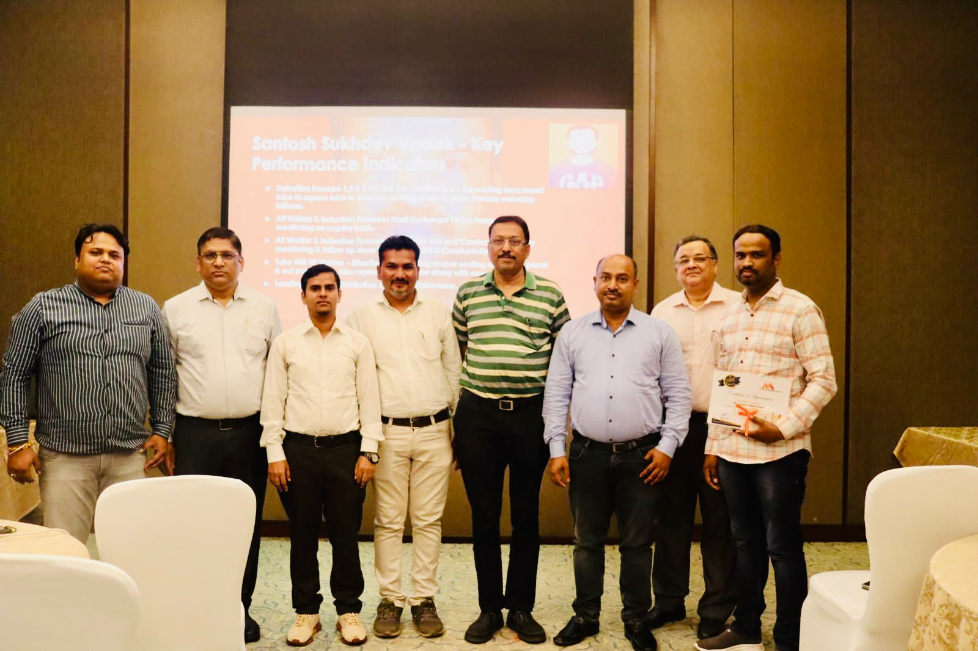
Glimpses of Department Performer – Maintenance
Mr. Sandip Pandarkar – Project

Slide 10
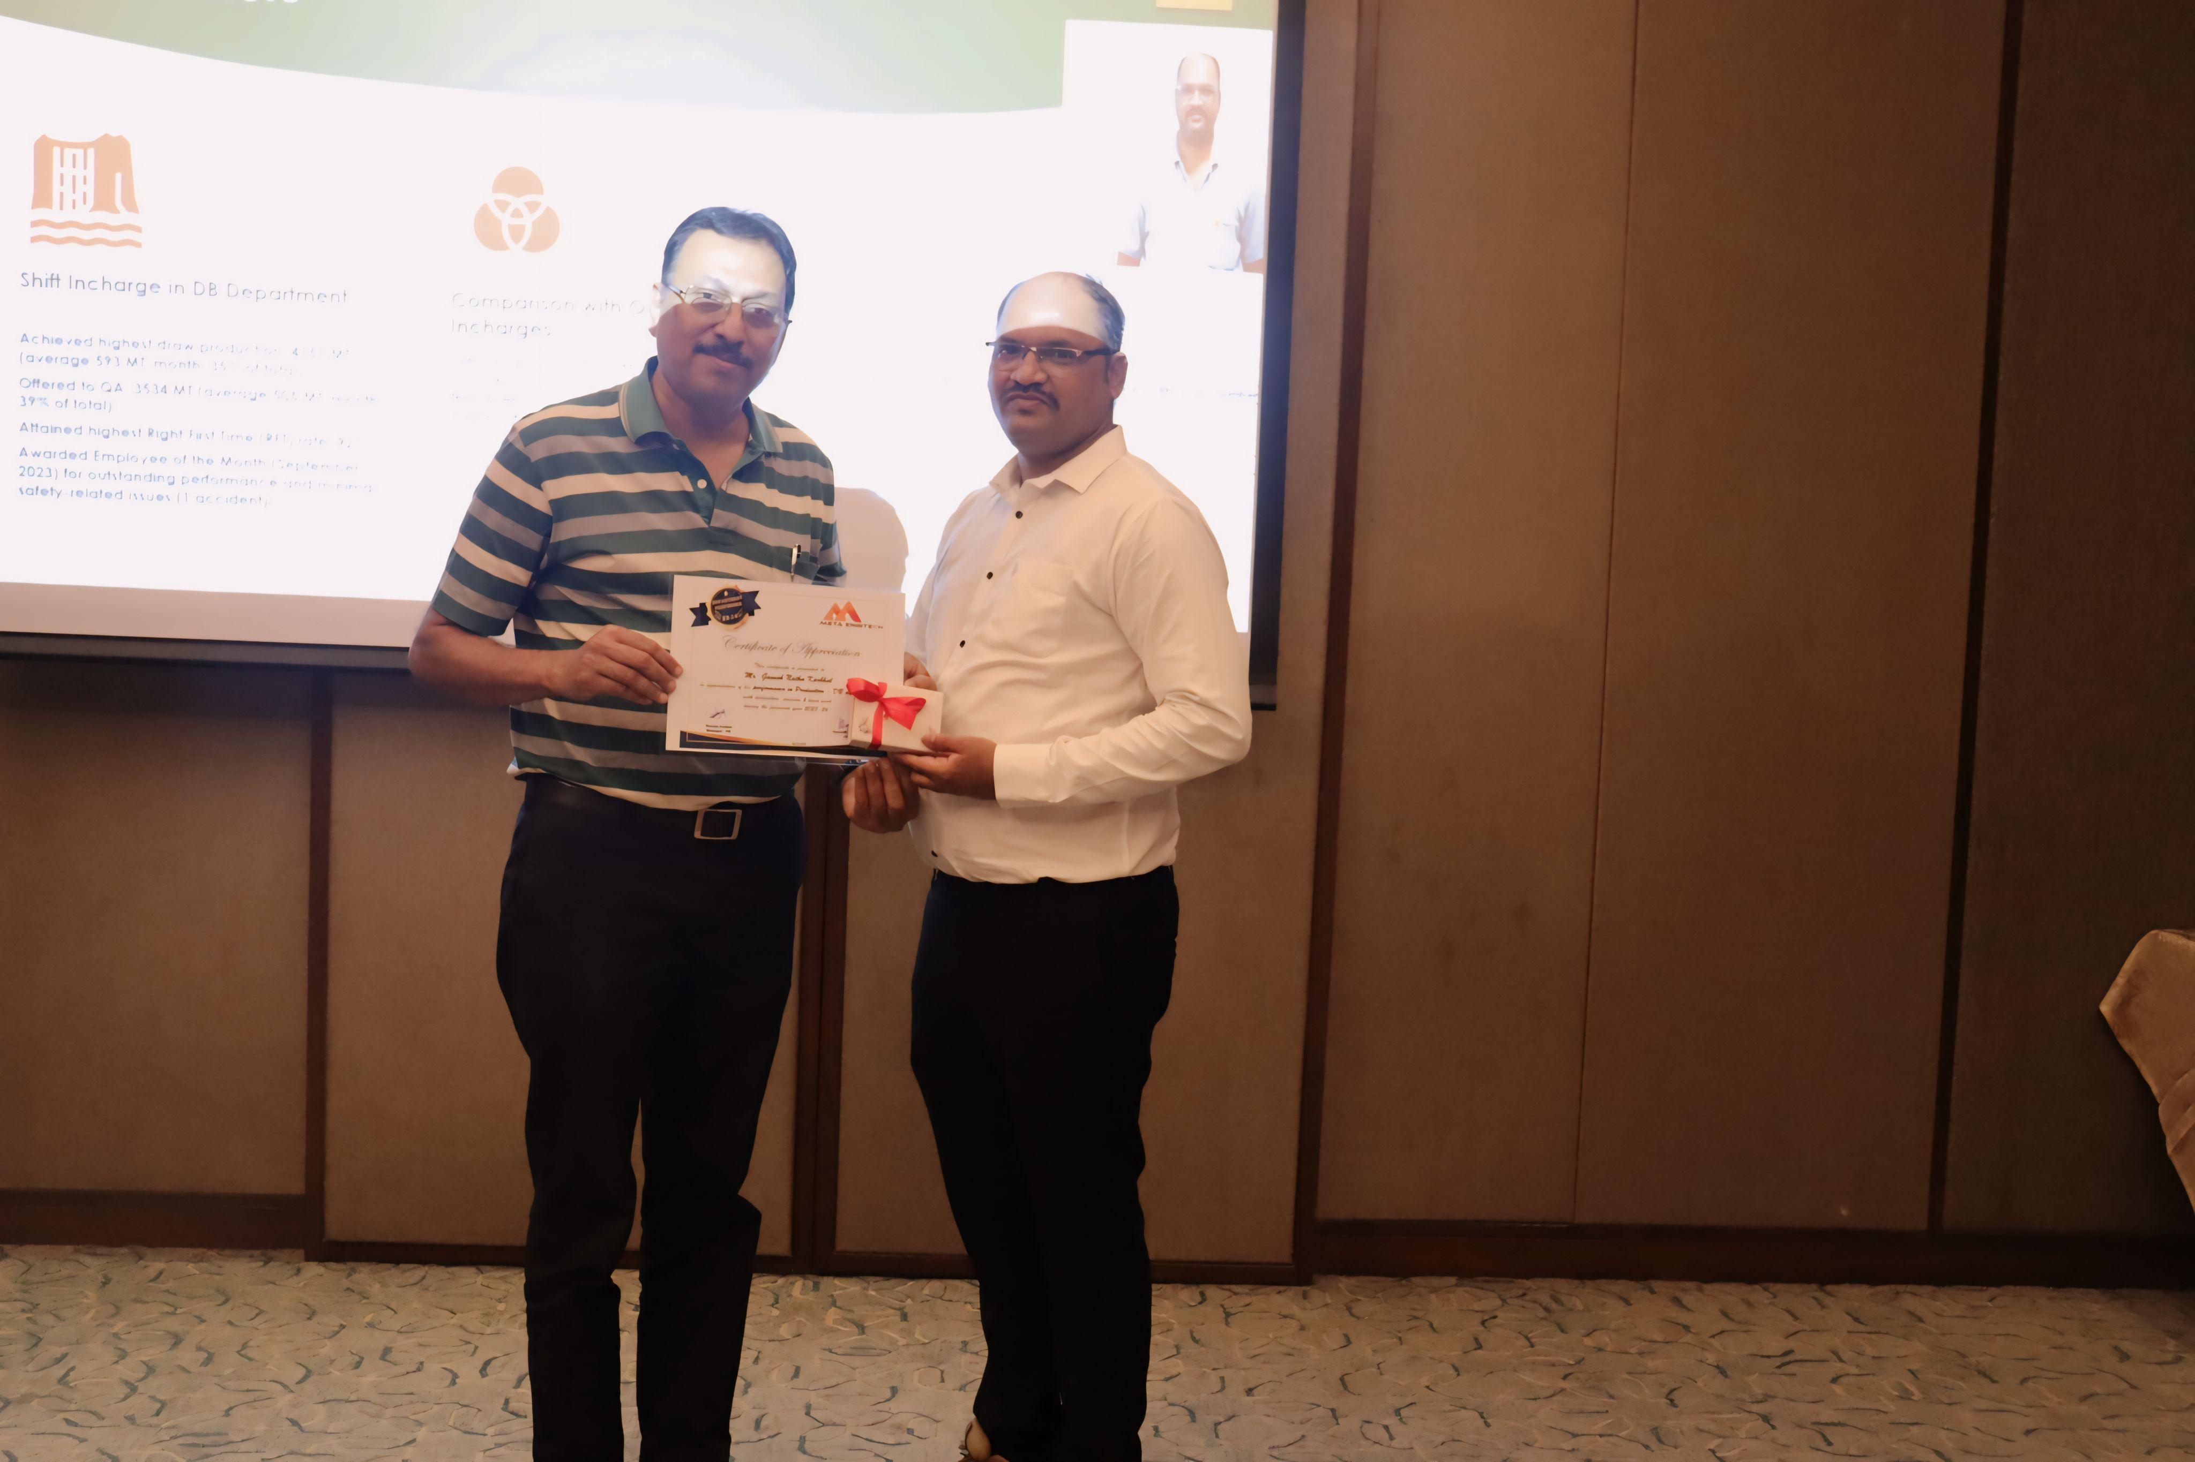
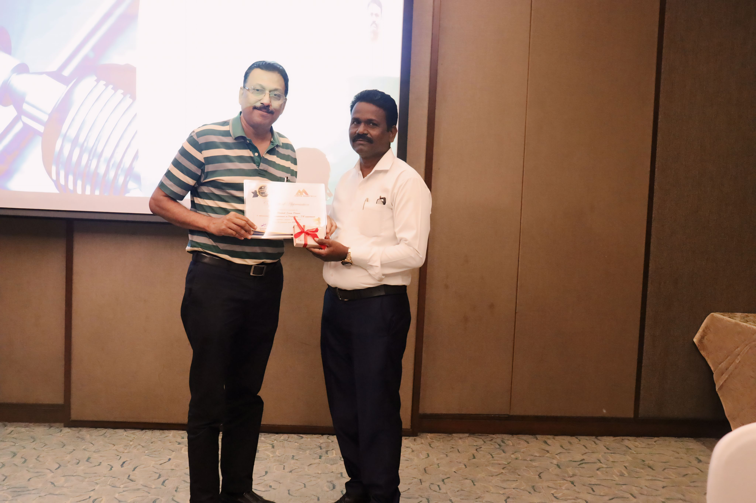
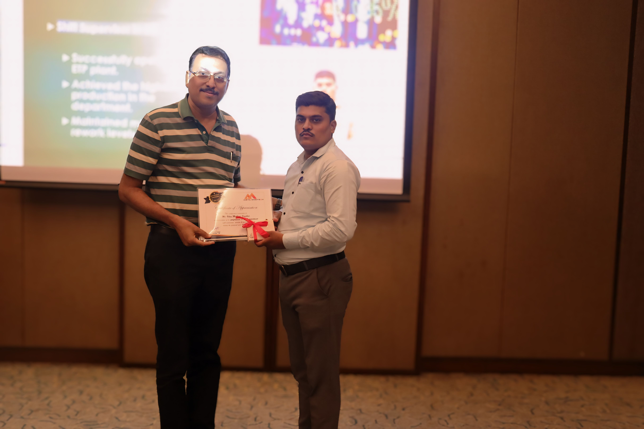
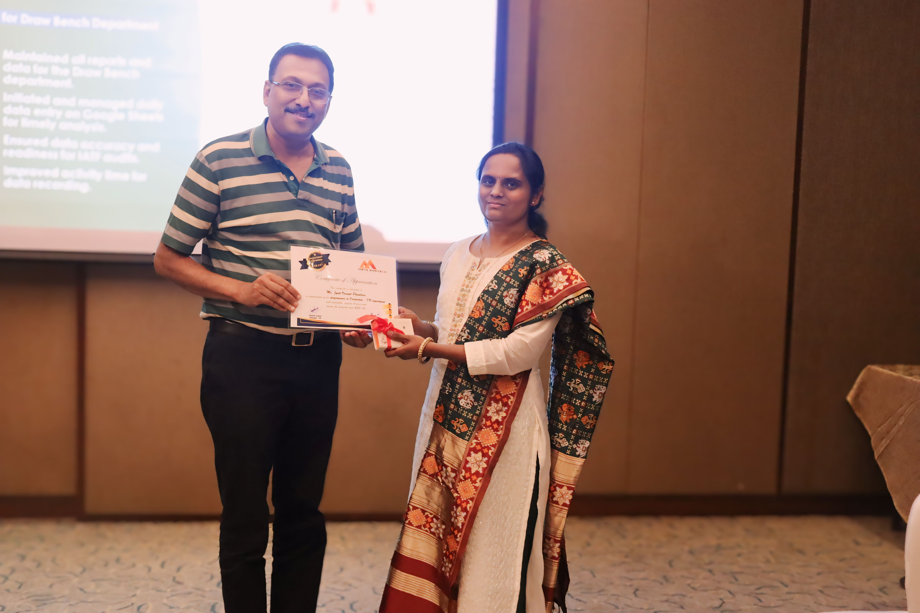
Glimpses of Department Performer – Production
Mr. Ganesh Karbhal – Production DB
Mr. Santosh Pawar – Production DB
Mr. Vilas Sondkar – STP
Mrs. Jyoti Phadtare – Production DB

Slide 11
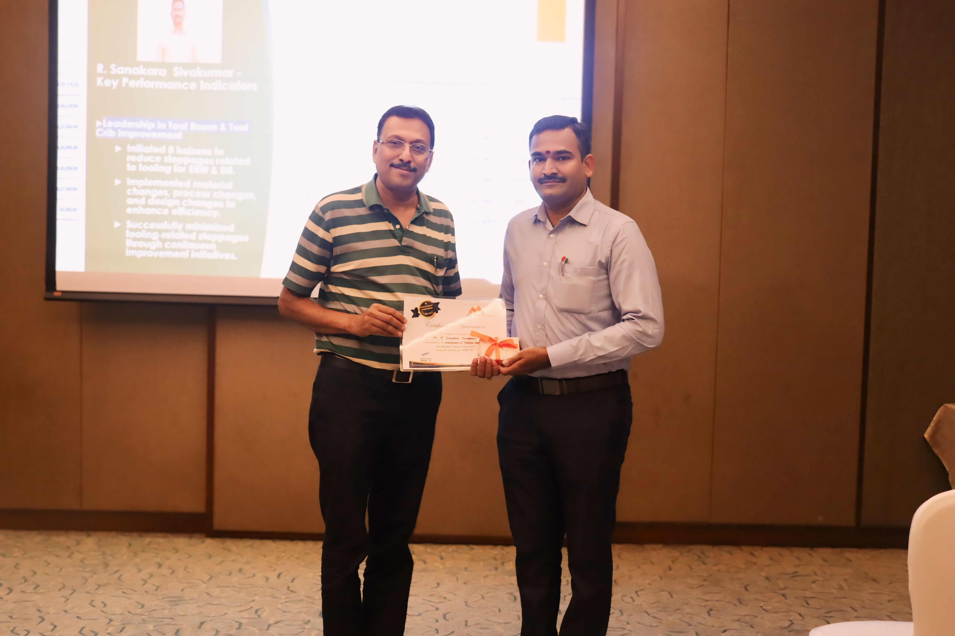
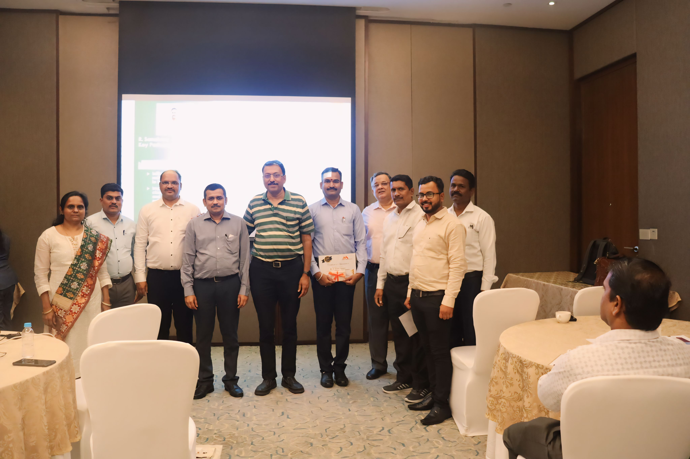
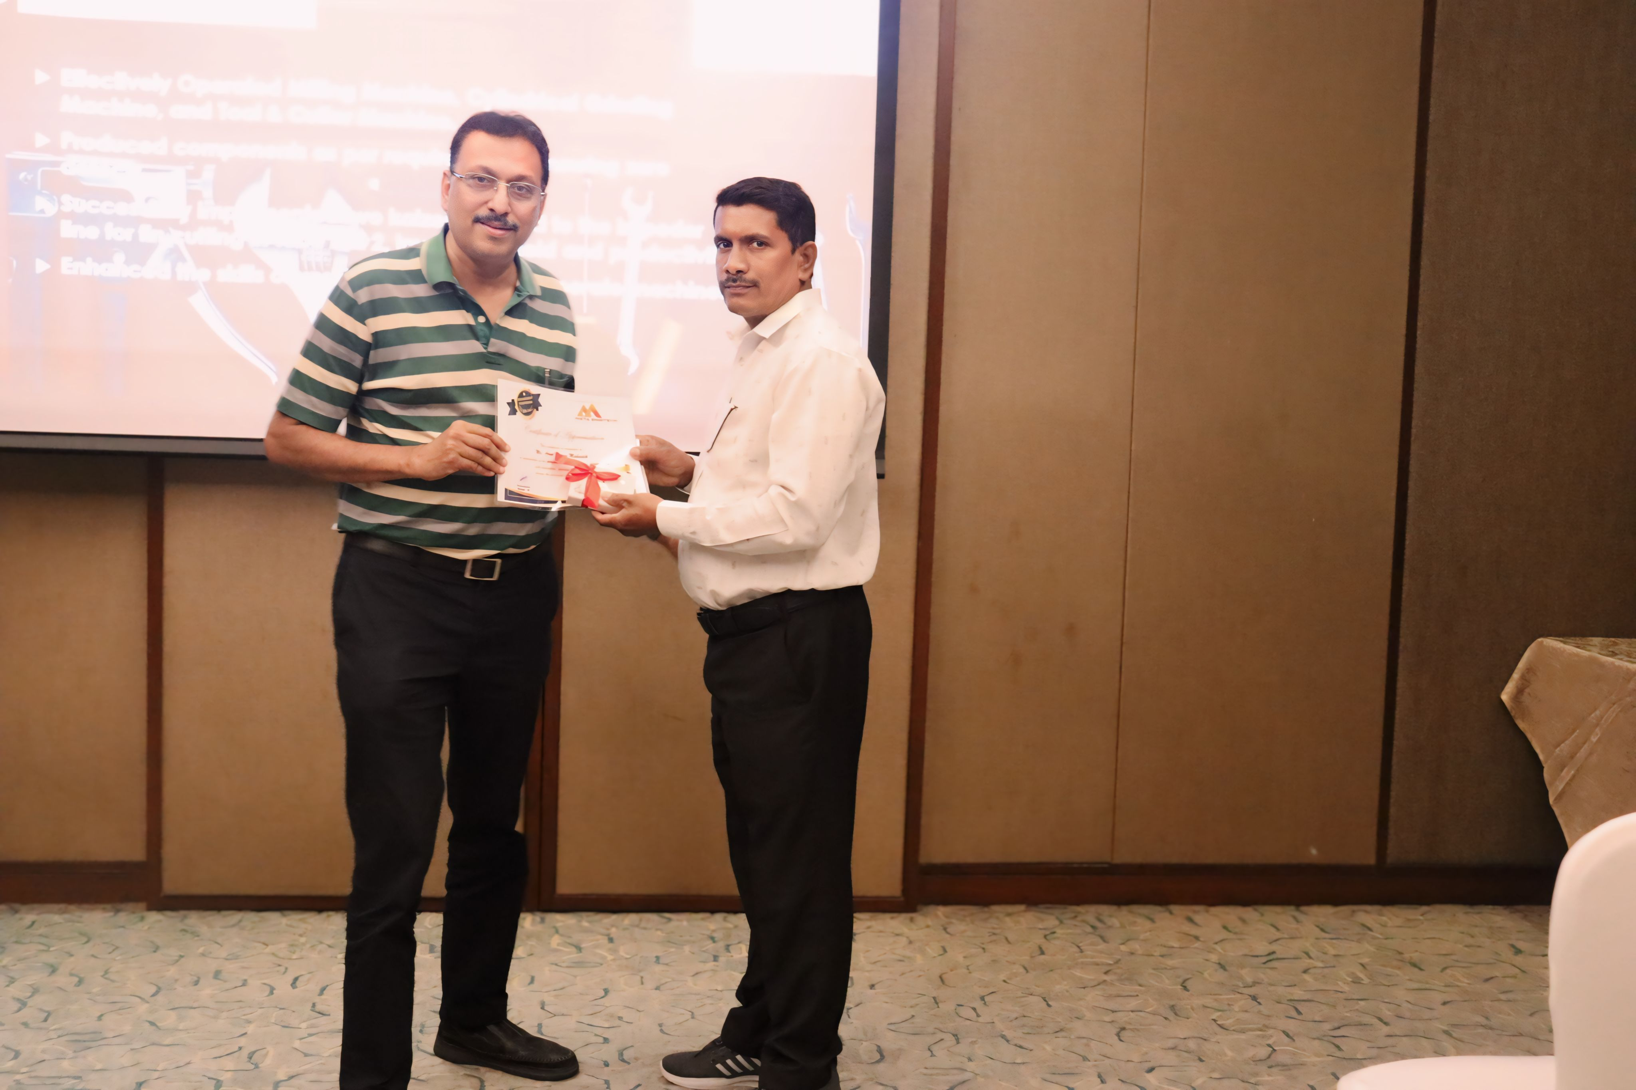
Glimpses of Department Performer – Production
Mr. R. Sanakara Sivakumar – Tool Room
Mr. Arun Mahadik – Tool Room

Slide 12
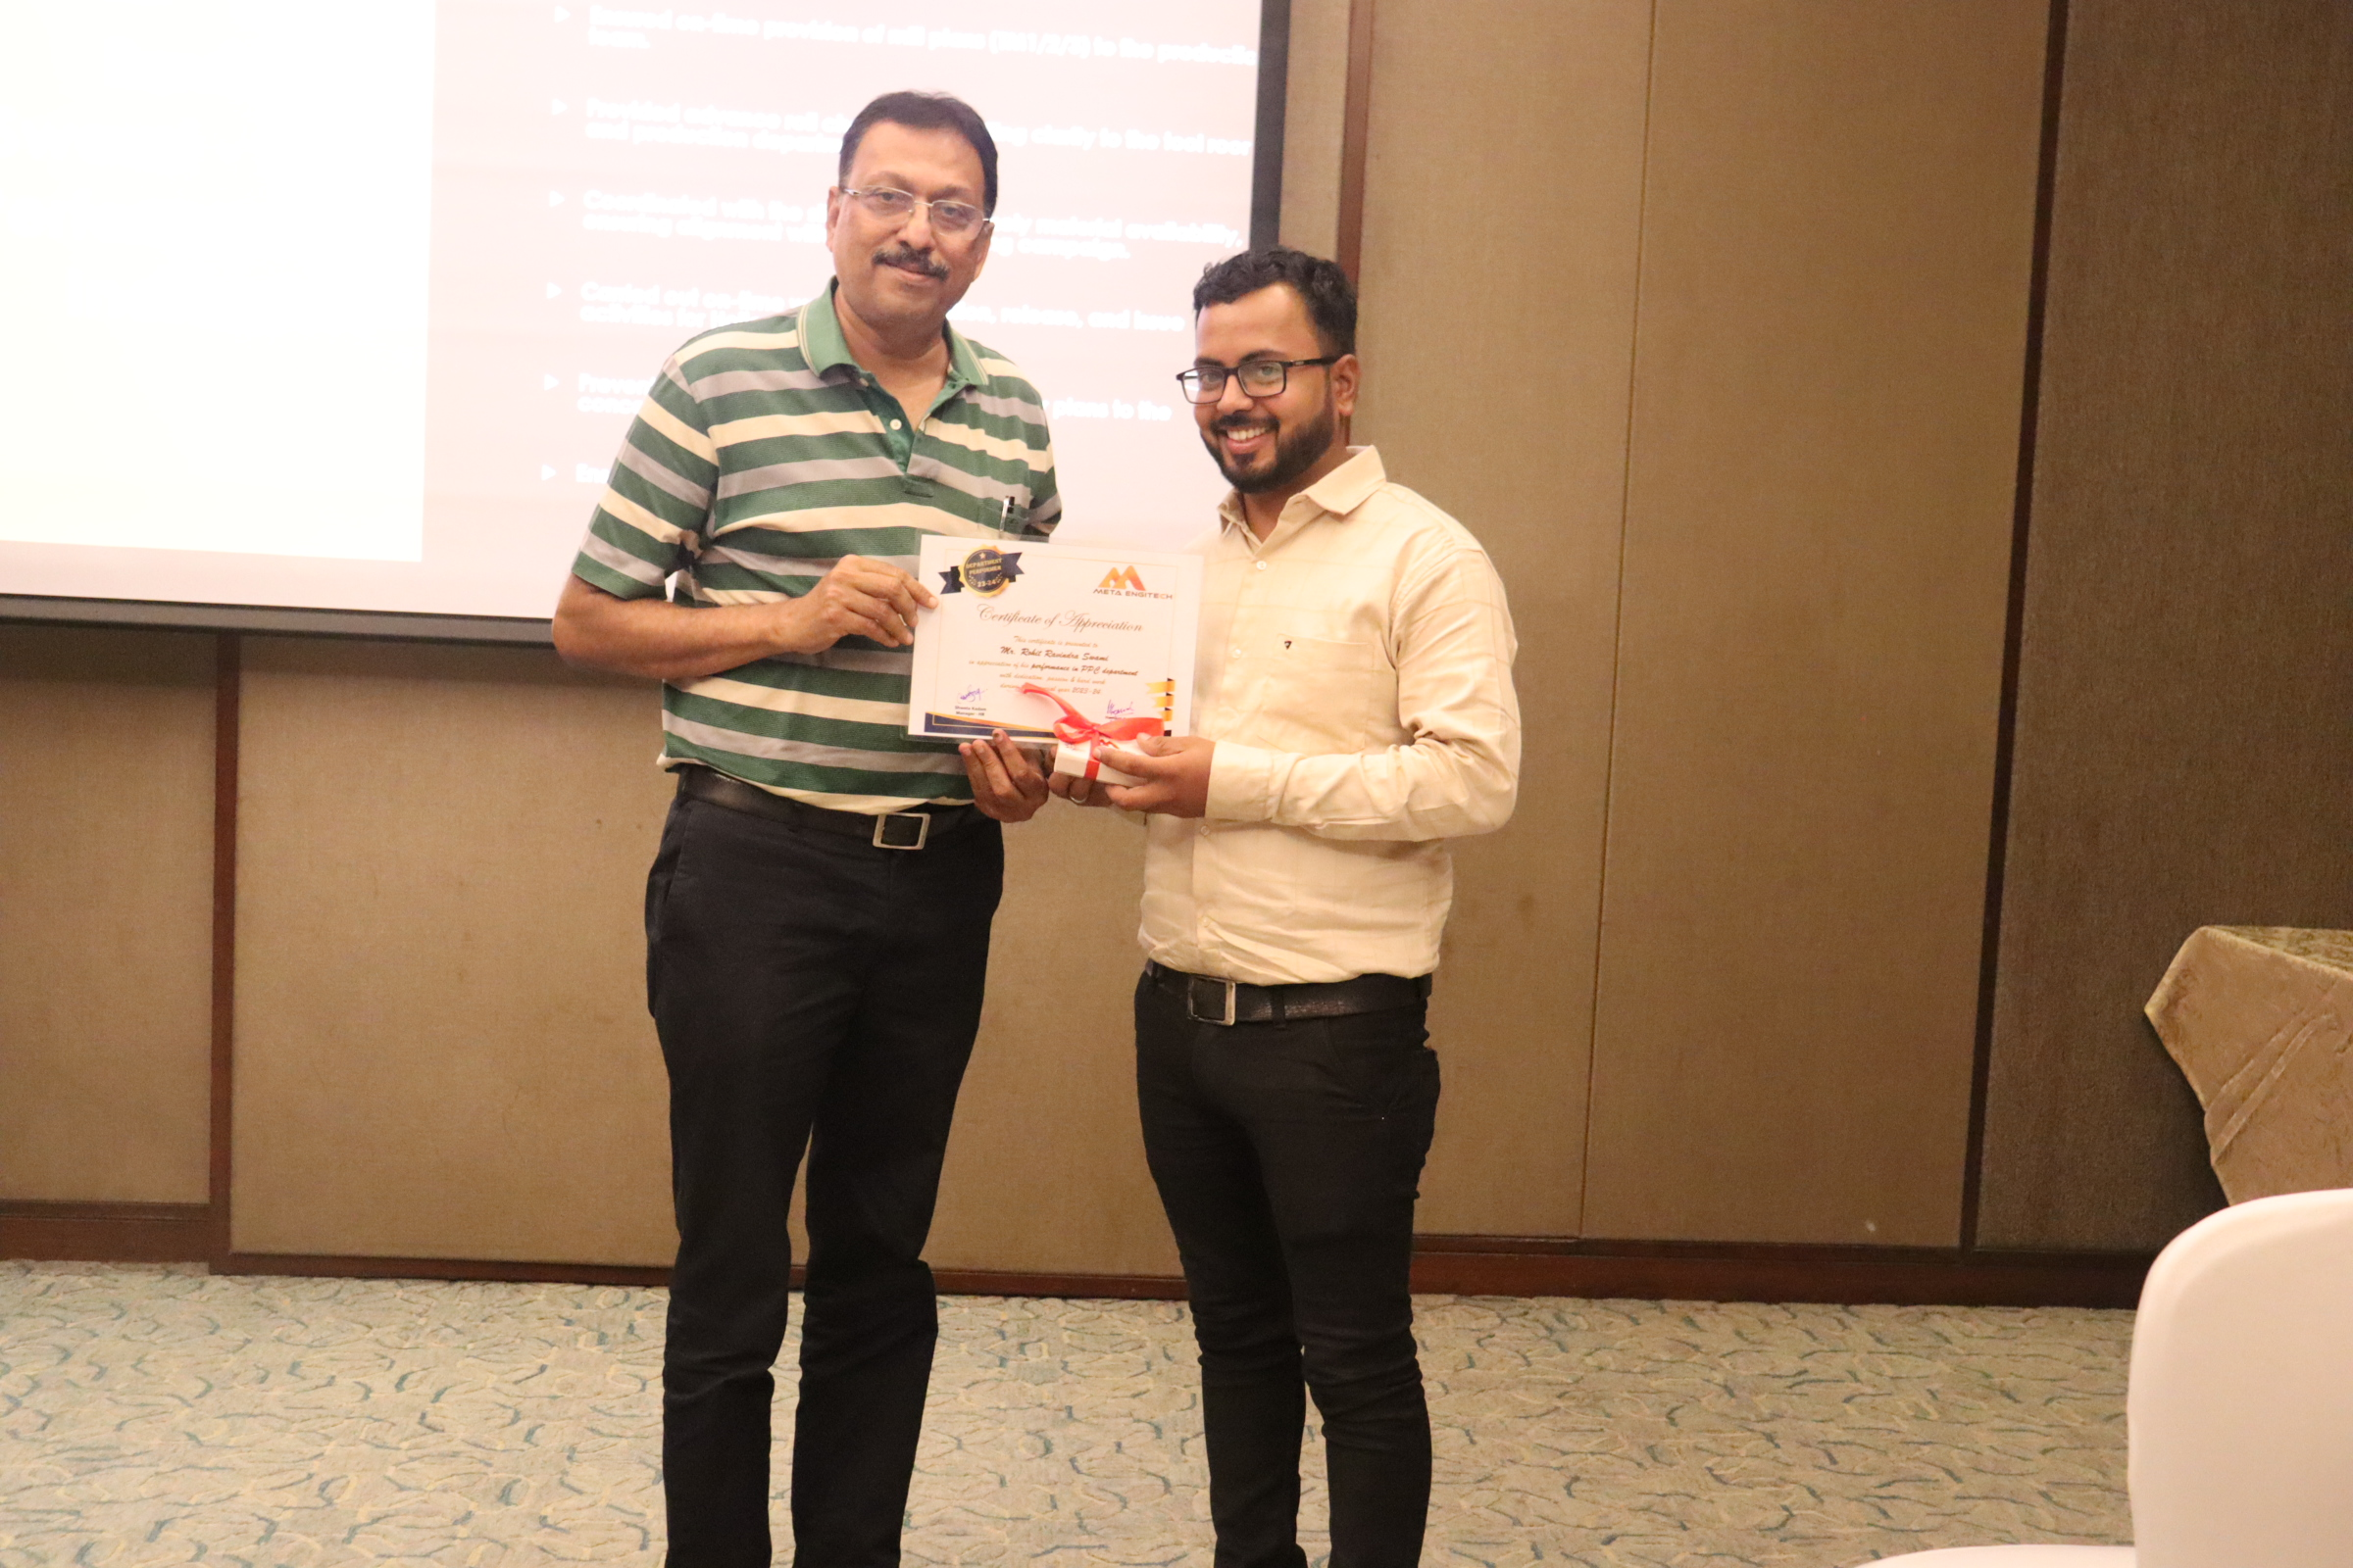
Glimpses of Department Performer – PPC & Purchase
Mr. Rohit Swami – PPC
Mr. Somnath Bhinge – Purchase

